Slide 1

Welcome Back
Lab 7-
Gaining Internet Credibility;
How to get other great websites to link to you

Slide 2
Lab 7
Expectations
Chat Support Available During Webinars
Knowing Your Resources
Webinar Process
Facebook Support
Search: Crexendo UP Website Competition
Online Resources
up.Crexendo.com/unr

Slide 3
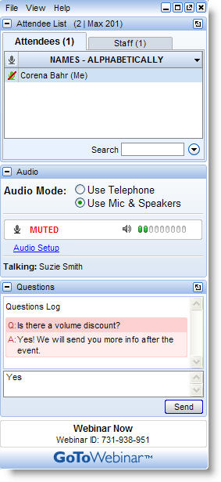
Lab 7
Live presentation
Attendees are muted
Type your questions in the “Questions” window
Questions answered live or via chat reply

Slide 4
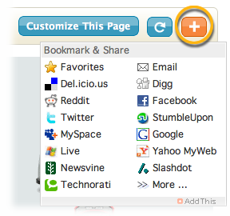
Lab 7 Review
Webinar 6 Review
The Popularity Contest
Creating Anchor Text
Blog Comments
Web 2.0 Properties
Free Live Directories
Paid Live Directories
Social Bookmarking
  Add This
    Facebook
    Twitter
    Google+ etc..
Q&A
Notes:
Web directories are large, topical, searchable directories that differ from traditional relevancy search engines in that their content is maintained by actual humans rather than by 'robot spyders' checking your site. Hence they are "live." Web directory personnel review your site and decide whether to include your website in their index. Sites in the index are located by browsing, by category, or by searching sites in the index using simple keyword matching. There are over a hundred Web directories on the Internet, each of varying importance. Nevertheless, your strategy should be to submit to all of them, if possible.

Slide 5
Lab 7
Webinar 6 Review
The Popularity Contest
Creating Anchor Text
Blog Comments
Web 2.0 Properties
Blogs
Videos
Forums
Awesome Site
Photos
Directories
Social Bookmarks
Web 2.0
Q&A
Notes:
Link trading = bad Creating links = Good
Make sure you’ve optimized your site first
The internet like high school, a popularity contest. Say you think you’re the best runner in the whole school. You can go around tooting your horn about how great you are at running, but how many people are going to believe you? Probably not very many since you’re the only one that seems to think you’re a great runner. However, if the Track Coach and the Student Body President and the Captain of the football team all start talking about how fast you are, how amazing you are at running…people are going to agree that you’re a good runner.
The same thing applies with search engines, Google in particular. Say you’re selling shoes and you’ve optimized your site saying you’re all about shoes Google will cache your site and maybe give you a page rank of NA, but they probably won’t do much else. However, if other sites that talk about shoes start linking back to your site, Google will take notice. The idea is to gain quality links on a number of types of sites that link back to your site.

Slide 6
Lab 7
Webinar 6 Review
The Popularity Contest
Creating Anchor Text
Blog Comments
Web 2.0 Properties
Anchor Text is the visible, clickable text in a hyperlink. The words contained in the anchor text can determine the ranking that the page will receive by search engines.
When creating external links you will use your keyword phrases as your Anchor Text. This tells Google that the site we are linking to is about that keyword.
“…clickable text in a <a href=“http://website.com”>hyperlink</a>. The words…”
Q&A
Notes:
Example sites with Anchor Text:
http://www.washingtonpost.com/sports/wizards/wizards-losing-tradition-makes-dc-sports-fans-hesitant-to-embrace-washingtons-nba-team/2011/10/26/gIQAd95YaM_story.html
Literally tells google why you’re linking.

Slide 7
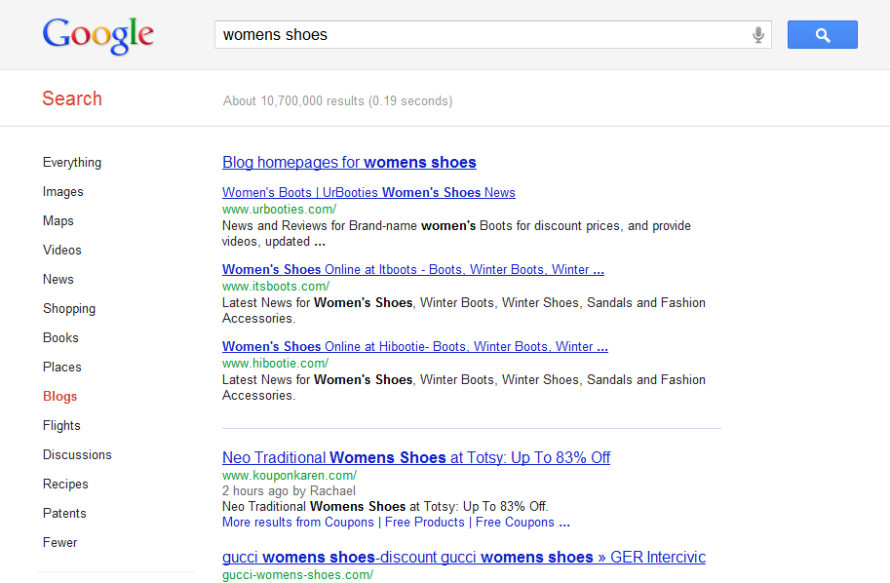
Lab 7
Webinar 6 Review
The Popularity Contest
Creating Anchor Text
Blog Comments
Web 2.0 Properties
Q&A
Notes:
Blogs/Discussions/Photos/Videos/Top 100 positions/Recipes/Shopping etc

Slide 8
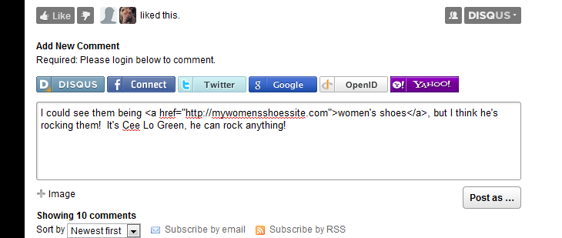
Lab 7
Webinar 6 Review
The Popularity Contest
Creating Anchor Text
Blog Comments
Web 2.0 Properties
Q&A
Notes:
Differences between blog comments and blogs promoting the site.
Make it natural, these are not promoting your site directly. They need to be relevant to the article, but not look like spam.

Slide 9
Lab 7
Webinar 6 Review
The Popularity Contest
Creating Anchor Text
Blog Comments
Web 2.0 Properties
A Web 2.0 is a web applications that facilitates information sharing, user-centered design, and collaboration on the Web.
A Web 2.0 site allows users to interact and collaborate with each other in a social media dialogue as creators of user-generated content in a virtual community.
Examples of Web 2.0 include social networking sites, blogs, wikis, video sharing sites, sites like Squidoo and other web applications.
Q&A
Notes:
Promotes site, interactive. Not made BY your site,

Slide 10
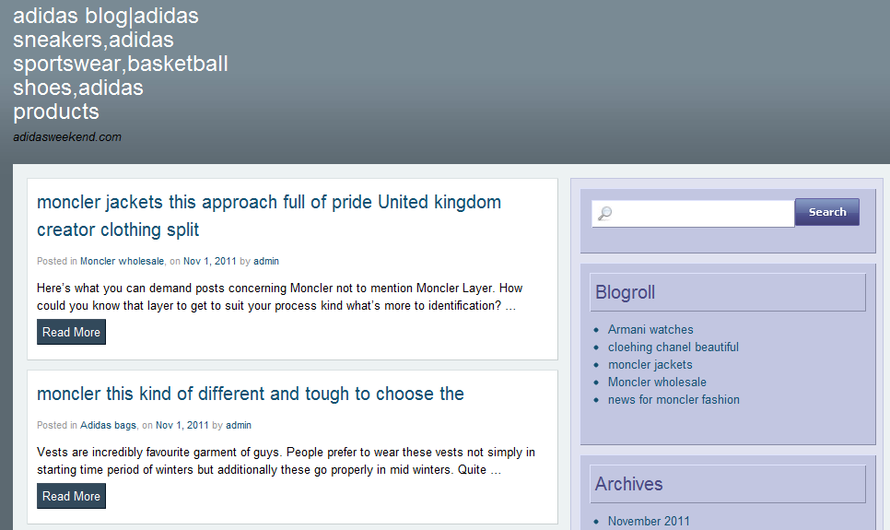
Lab 7
Webinar 6 Review
The Popularity Contest
Creating Anchor Text
Blog Comments
Web 2.0 Properties
Creating Blogs
∙ Blogger
∙ Wordpress
∙ Thoughts.com
Q&A
Notes:
http://www.adidasweekend.com/

Slide 11
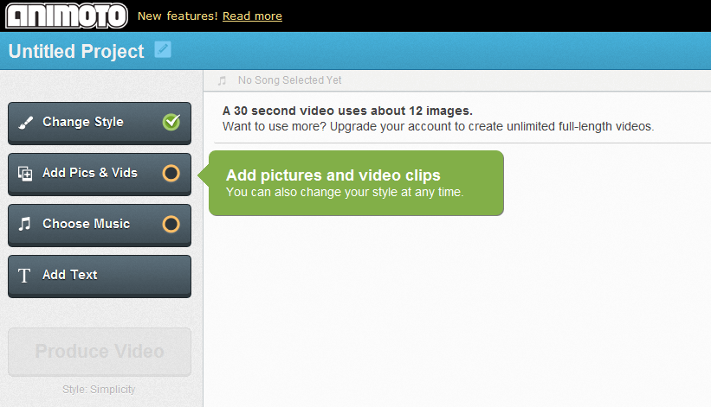
Lab 7
Webinar 6 Review
The Popularity Contest
Creating Anchor Text
Blog Comments
Web 2.0 Properties
Creating Videos
∙ Flixtime
∙ Animoto
Q&A

Slide 12
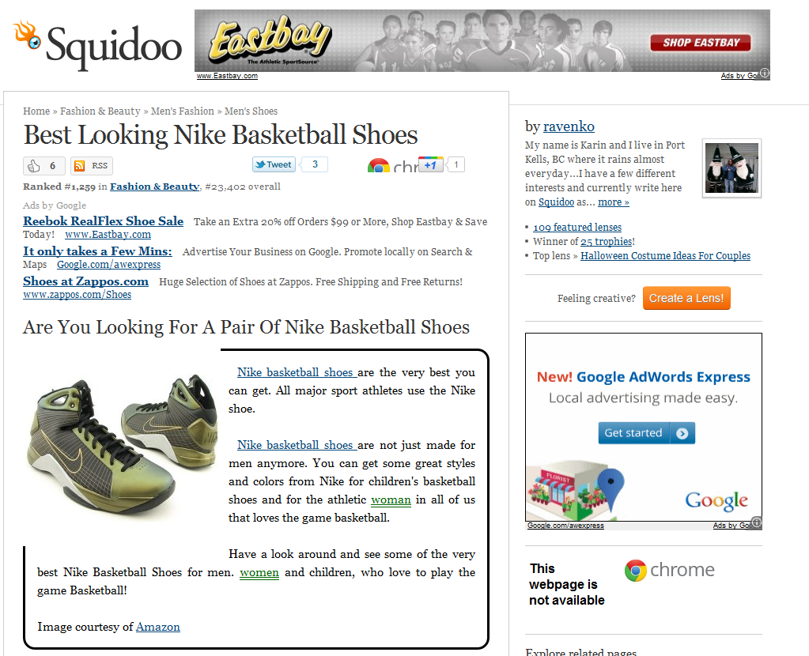
Lab 7
Webinar 6 Review
The Popularity Contest
Creating Anchor Text
Blog Comments
Web 2.0 Properties
Other Web 2.0
∙ Squidoo
∙ WikiHow
∙ Landing Pages
Q&A
Notes:
http://www.squidoo.com/best-looking-nike-basketball-shoes
http://www.wikihow.com/Pick-out-Basketball-Shoes

Slide 13

Lab 7
Webinar 6 Review
The Popularity Contest
Creating Anchor Text
Blog Comments
Web 2.0 Properties
Questions
Answers
Q&A

